Slide 2
Objectives
List and explain text and font styles
^{Describe inline spans}
Explain paragraph indentation and application of border
Explain horizontal paragraph alignment
Explain vertical spacing within a paragraph

Slide 3
Text and Font Style 1-2
The text properties specify and control the appearance of the text in a Web page.
A user can change the color of a text, increase or decrease the space between characters, align a text, and so on using the text properties.
Following table lists different text properties.
^{Property} | ^{Description}
^{color} | It is used for specifying the color of the text.
^{text-align} | It is used in specifying the horizontal alignment of text in an element.
^{text-decoration} | It is used for specifying the decoration of the text in an element.
^{text-indent} | It is used for specifying the indentation of first line of text in an element in length or %.
^{text-transform} | It is used in specifying the casing of text in an element.
^{word-spacing} | It is used for increasing or decreasing the space between words.

Slide 4
Text and Font Style 2-2
The font properties allow you to specify the font for the text and change the different font attributes of the text such as font, size, and style of the text.
Following table lists the different font properties.
^{Property} | ^{Description}
^{font-family} | It is used for specifying the font and can specify a generic family or a specific family name such as “Serif” or “Times New Roman”.
^{font-size} | It is used for specifying the size of the font and can have an absolute or relative value.
^{font-style} | It is used for specifying the style of the font.
^{font-variant} | It is used for specifying whether the text should be displayed in small-caps.

Slide 5
Text Styles 1-8
The different text styles such as text-align, text-indent, and text-transform provide different values that allow specifying the alignment, indentation, and casing of text in an element.
The text-align property allows the text to be centered, or left or right aligned, or justified.
^{Following} table lists the values of text-align property.
^{Value} | ^{Description}
^{left} | It is used for aligning the text to the left of the Web page.
^{right} | It is used for aligning the text to the right of the Web page.
^{center} | It is used for aligning the text in the middle of the Web page.
^{justify} | It is used for justifying the text on both sides of the Web page.

Slide 6
Text Styles 2-8
The text-indent property is used for specifying the indentation of the text.
Following table lists the values of text-indent property.
^{Value} | ^{Description}
^{length} | It is used in specifying fixed indentation and the default value is 0.
% | It is used to specify an indentation as a percentage of the width of the parent element which the selector element is defined.
The text-transform property is for changing the case of letters in a text.
Following table lists the values of text-transform property.
^{Value} | ^{Description}
^{none} | It is used in specifying that the text will be displayed with the same casing as written within the element.
^{capitalize} | It is used in specifying that the first letter of each word will be capitalized.
^{Uppercase} | It is used in specifying only uppercase letters.
^{Lowercase} | It is used in specifying only lowercase letters.

Slide 7
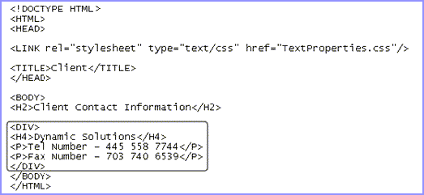
Text Styles 3-8
Following figure shows DIV element HTML code.

Slide 8
Text Styles 4-8
CSS Code
Following figure displays a CSS code that specifies the text styles for the DIV element.
The text-align property is set to left, which will align the text towards the left.
The text-indent property is set to 2em, which will indent the text with respect to the font size.
The text-transform property is set to uppercase, which will display all the letters in uppercase.

Slide 9
Text Styles 5-8
The text specified in the DIV element is aligned towards the left and all the letters are displayed in uppercase.
Following figure shows the output.
The text-decoration and word-spacing properties provides different values that allow the user to specify the decoration and word spacing of text in an element.

Slide 10
Text Styles 6-8
Following table lists the values assigned to the text-decoration property.
^{Value} | ^{Description}
^{none} | It is used for displaying normal text without any formatting.
^{underline} | It is used for displaying a line under the text.
^{overline} | It is used for displaying a line over the text.
^{line-through} | It is used for displaying a line through the text.
^{blink} | It is used for flashing the text.
Following table lists the values assigned to the word-spacing property.
^{Value} | ^{Description}
^{normal} | It is used in specifying normal spacing between words and it is the default value.
^{length} | It is used in specifying fixed space between words.

Slide 11
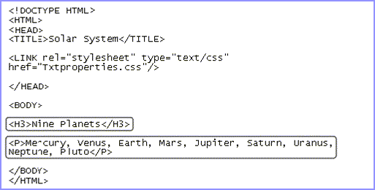
Text Styles 7-8
Following figure shows the header and paragraph HTML code.

Slide 12
Text Styles 8-8
Following figure displays a CSS code that specifies the text properties for the BODY and H3 elements.
The word-spacing property is set to 2px for the BODY element.
The text-decoration property is set to underline for the H3 element.
Following figure shows the header and paragraph HTML code.
The header is underlined and each word in the header and the paragraph is displayed by leaving a distance of two pixels between them.

Slide 13
Inline Span 1-2
The <span> tag groups inline-elements in a document.
For example, if one word in a sentence needs to be bold or colored without using the <b> tag then a <span> tag is used which can be present within an existing tag.
The Code Snippet demonstrates CSS inline style for <span> tag.
<p>My mother has <span style=”color: lightblue”>light blue
^{</span> eyes.}
^{</p>}
^{Or}
<span class=”eyesonly”>light blue</span>
The Code Snippet demonstrates CSS external style for <span> tag.
.eyesonly {font-color: lightblue}
The span tag has different attributes; it supports JavaScript event attributes also.

Slide 14
Inline Span 2-2
Following table lists different attributes and values used in <span> ^{tag.}
^{Attribute} | ^{Value} | ^{Description}
^{class} | ^{classname} | It is used in specifying the text direction for the content in an element.
^{dir} | ^{rtl} ^{ltr} | It is used in specifying the text direction for the content in an element.
^{id} | ^{id} | It is used in specifying a unique id for an element.
^{lang} | ^{language_code} | It is used in specifying a language code for the content in an element.
^{style} | ^{style_definition} | It is used in specifying an inline style for an element.
^{title} | ^{text} | It is used in specifying extra information about an element.
^{xml:lang} | ^{language_code} | It is used in specifying a language code for the content in an element, in XHTML documents.

Slide 15
Indenting Paragraph 1-6
Indenting is the process of setting off the text from its normal position, either to the left or to the right.
In paragraph style, there are three types of indentation:
First line indent
The text–indent property is used in the CSS for indenting the first line of a paragraph.
The Code Snippet demonstrates inline style for <p> tag and an internal CSS code for first line indent.
^{Inline style}
^{<p style=”text-indent: 50px”>}
^{Internal CSS}
^{p {text-indent: 50px}}

Slide 16
Indenting Paragraph 2-6
The Code Snippet demonstrates the use of the text–indent property in the HTML file.
^{<!DOCTYPE HTML>}
^{<html>}
^{<head>}
^{<title>Font Gallery</title>}
^{<style>}
^{p {text-indent: 150px}}
^{</style>}
^{</head>}
^{<body>}
^{<p>}
The font styles properties allow you to specify the font for the text. They allow
you to change the different font attributes of the text such as font, size, and style
of the text. The browser must support the font specified by the font properties.
Otherwise, it will display the default font, which is dependent on the browser.
^{</p>}
^{</body>}
^{</html>}

Slide 17
Indenting Paragraph 3-6
Following figure shows the output of text-indent property.
Padding
The padding property is used to add a specified amount of space between the border of an element and its contents.
The Code Snippet demonstrates inline style for <p> tag and an internal CSS code for padding property.
^{Inline style}
^{<p style=”padding: 20px”>}
^{Internal CSS}
^{p {padding: 20px}}

Slide 18
Indenting Paragraph 4-6
The Code Snippet demonstrates the use of the text–indent property in the html file.
^{<!DOCTYPE HTML>}
^{<html>}
^{<head>}
^{<title>Font Gallery</title>}
^{<style>}
^{p {padding: 20px }}
^{</style>}
^{</head>}
^{<body>}
^{<p>}
The font styles properties allow you to specify the font for the text. They allow you
to change the different font attributes of the text such as font, size, and style of
the text. The browser must support the font specified by the font properties.
Otherwise, it will display the default font, which is dependent on the browser.
^{</p>}
^{</body>}
^{</html>}

Slide 19
Indenting Paragraph 5-6
Following figure shows the padding property.
Margin
The margin property is used to add a specified amount of white space around an element, on the outside of the element.

Slide 20
Indenting Paragraph 6-6
Following code snippet demonstrates inline style for <p> tag and an internal CSS code for margin property.
^{Inline style}
^{<p style=”margin: 20px”>}
^{Internal CSS}
^{p {margin: 20px}}
Following figure shows the output of margin property.

Slide 21
Border Style 1-7
Borders are rectangular outlines that surround an element.
Borders present around text and an image emphasize the content inside the text box.
CSS border properties specify the style, color, and width of the border.
Following table lists the border-style properties.
^{Property} | ^{Description}
^{border-left-style} | It sets an element’s left border.
^{border-right-style} | It sets an element’s right border.
^{border-top-style} | It sets an element’s top border.
^{border-bottom-style} | It sets an element’s bottom border.

Slide 22
Border Style 2-7
Following table lists the values of the border-style properties.
^{Value} | ^{Description}
^{Dashed} | It is used for specifying a dashed border.
^{Dotted} | It is used for specifying a dotted border.
^{Double} | It is used for specifying two borders.
^{groove} | It is used for specifying a 3D grooved border.
^{Inset} | It is used for specifying a 3D inset border.
^{outset} | It is used for specifying a 3D outset border.
^{ridge} | It is used for specifying a ridged border.
^{solid} | It is used for specifying a solid border.

Slide 23
Border Style 3-7
Following figure shows an HTML code.
Following figure shows CSS code of border style.

Slide 24
Border Style 4-7
^{Explanation for code.}
^{border-left-style: ridge;}
Applies a ridged border to the left.
^{border-right-style: groove;}
Applies a 3D grooved border to the right.
^{border-top-style: dashed;}
Applies a dashed border at the top.
^{border-bottom-style: double;}
Applies two borders at the bottom.
Following figure shows the output of border-style properties.

Slide 25
Border Style 5-7
Shorthand property
To make the code concise CSS allows certain shorthand properties to reduce the length of the code.
The shorthand property for setting the border is border-style.
Following figure shows Sample HTML Code.

Slide 26
Border Style 6-7
Following figure shows CSS code of shorthand border-style properties.
^{Explanation for code.}
border-style: groove inset outset dashed;
Applies a 3D grooved border at the top, 3D inset border at the right, 3D outset border at the bottom, and dashed border at the left.

Slide 27
Border Style 7-7
Following figure shows output of shorthand border-style properties.

Slide 28
Border Color 1-6
The border-color property in CSS applies colors to all the four borders.
One can also apply four different colors to four borders.
There are other border color properties that allow a user to individually specify colors of the left, right, top, or bottom border.
Following table lists the different border color properties.
^{Property} | ^{Description}
^{border-bottom-color} | It is used to specify the color for the bottom border.
^{border-left-color} | It is used to specify the color for the left border.
^{border-right-color} | It is used to specify the color for the right border.
^{border-top-color} | It is used to specify the color for the top border.

Slide 29
Border Color 2-6
The border-color property accepts different color values that determine the different shades of color to be applied to the borders.
Following table lists the values of the different border-color properties.
^{Value} | ^{Description}
^{color} | It is used in specifying the color to be applied to the border by using either the RGB or hexadecimal value, or the color name itself.
^{transparent} | It is used for specifying that the border is transparent.

Slide 30
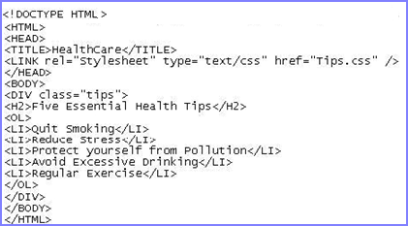
Border Color 3-6
Following figure shows an HTML code with properties.

Slide 31
Border Color 4-6
Following figure shows the CSS code of border-color properties.
^{Explanation for code.}
^{border-bottom-color: #FF0000;}
Displays the bottom border in red color.
^{border-top-color: #FF0000;}
Displays the top border in red color.
^{border-right-color: #0000FF;}
Displays the right border in blue color.
^{border-left-color: #0000FF;}
Displays the left border in blue color.

Slide 32
Border Color 5-6
Shorthand property
The shorthand property for setting the color of the border is border-color.
Following figure shows an HTML code of a table with border-color properties.

Slide 33
Border Color 6-6
Following figure shows CSS code off shorthand border-color.
^{Explanation for code.}
border-color: Red Blue Green Yellow;
Displays the top border in red, right border in blue, bottom border in green and left border in yellow color.

Slide 34
Border Width 1-7
The border-width property is a shorthand property used to specify the width for all the four borders.
There are other border-width properties that allow a user to individually specify the left, right, top, or bottom borders.
Following table lists the different border-width properties.
^{Property} | ^{Description}
^{border-bottom-width} | It is used to specify the width of the bottom border.
^{border-left-width} | It is used to specify the width of the left border.
^{border-right-width} | It is used to specify the width of the right border.
^{border-top-width} | It is used to specify the width of the top border.

Slide 35
Border Width 2-7
The values of the border width properties specify the way the border will appear.
Following table lists the values of the different border-width properties.
^{Value} | ^{Description}
^{medium} | It is used in specifying a medium border.
^{length} | It is used in accepting an explicit value that specifies the thickness of border.
^{thick} | It is used for displaying a thick border.
^{thin} | It is used in specifying a thin border.

Slide 36
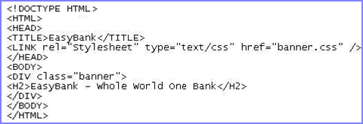
Border Width 3-7
Following figure shows an HTML code for border-width properties.
Following figure shows the CSS code of border-width properties.

Slide 37
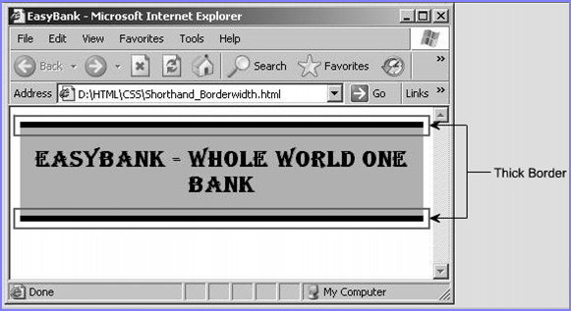
Border Width 4-7
^{Explanation for code.}
^{border-top-width: thick;}
^{Displays a thick top border.}
^{border-bottom-width: thick;}
Displays a thick bottom border.
Following figure shows the output of border-width properties.

Slide 38
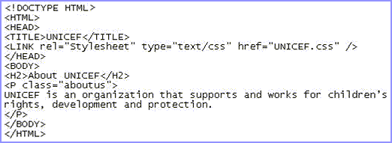
Border Width 5-7
Shorthand property
The shorthand property for setting the border is border-width.
Following figure shows an HTML code using the shorthand border-width properties.

Slide 39
Border Width 6-7
Following figure shows the CSS code using the shorthand property, border-width.
^{Explanation for code.}
border-width: thick thin thick thin;
Specifies a top and bottom border as thick and right and left border as thin.

Slide 40
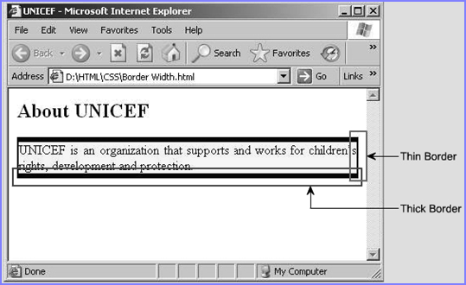
Border Width 7-7
Following figure shows output using shorthand code of border-width properties.

Slide 41
Shorthand Border 1-6
The border shorthand property in CSS specifies all the properties such as style, width, and color for all the four borders.
It allows the user to specify the different properties in just one declaration.
One can also set these properties individually by using the different shorthand border properties.
Following table lists the different shorthand border properties.
^{Property} | ^{Description}
^{border-bottom} | It is used to specify the width, style, and color of the bottom border.
^{border-left} | It is used to specify the width, style, and color of the left border.
^{border-right} | It is used to specify the width, style, and color of the right border.
^{border-top} | It is used to specify the width, style, and color of the top border.

Slide 42
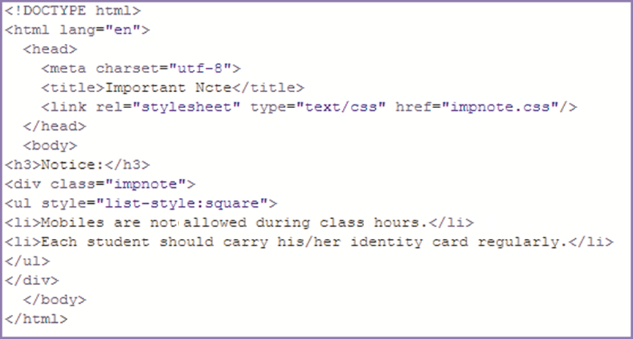
Shorthand Border 2-6
Following figure shows an HTML code for shorthand border properties.

Slide 43
Shorthand Border 3-6
Following figure shows a CSS code using different shorthand border properties.
^{Explanation for code.}
border-top: dashed thin #FF0000;
Displays a thin top border with a dashed line in red color.
border-bottom: ridge thick #0000FF;
Displays a thick ridged bottom border in blue color.

Slide 44
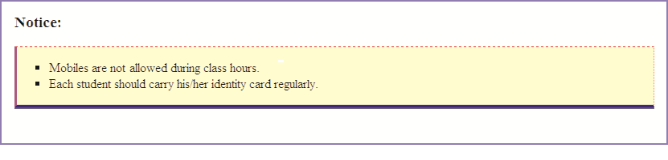
Shorthand Border 4-6
border-right: dotted thin #FF8040;
Displays a thin right border with a dotted line in orange color.
border-left: inset medium #FF00FF;
Displays a medium 3D inset left border in purple color.
Following figure shows the output of border properties.

Slide 45
Shorthand Border 5-6
Following figure shows an HTML and CSS code of image border property.

Slide 46
Shorthand Border 6-6
^{Explanation for code.}
^{border: solid thin #FF0000;}
Specifies that all the four borders must be solid in style, thin by width, and red in color.
Following figure shows the output of Image Border property.

Slide 47
Horizontal Alignment 1-2
In CSS, text-align property is used for horizontal alignment of text in an element.
This property aligns the inline content of a block.
Following table lists all values of text-align property.
^{Value} | ^{Description}
^{left} | ^{Aligns the text to the left.}
^{right} | ^{Aligns the text to the right.}
^{center} | ^{Centers the text.}
^{justify} | Aligns text to both left and right margins by adding space between words (like in newspapers and magazines).
^{inherit} | Specifies that the value of the text-align property should be inherited from the parent element.

Slide 48
Horizontal Alignment 2-2
The text-align property applies only to block-level elements, such as paragraphs.
Hence, text-align cannot change the alignment of a single word without changing the alignment of the entire line.
For Western languages, which are read from left to right, the default value of text-align is left.
The text aligns on the left margin and has a ragged right margin.
Languages such as Hebrew and Arabic has default align to right since they are read from right to left.

Slide 49
Vertical Alignment
In CSS line-height property is used for vertical alignment of text in an element.
This property is also a component of the ‘font’ shorthand property.
It can be applied on block-level elements, table cells, table caption, and so on.
^{Value} | ^{Description}
^{normal} | A normal line height. This is default.
^{number} | A number that will be multiplied with the current font size to set the line height.
^{length} | A fixed line height in px, pt, cm, and so on.
% | A line height in percent of the current font size.
^{inherit} | Specifies that the value of the line-height property should be inherited from the parent element.

Slide 50
Summary
The text styles specify and control the appearance of the text in a Web page.
Indenting is the process of offsetting text from its normal position, either to the left or to the right.
CSS border property specifies the style, color, and width of the border.
The border-color property accepts different color values that determine the different shades of color to be applied to the borders.
The values of the different border properties determine the type of effect to be applied to the borders.
In CSS, text-align property is used for horizontal alignment of text in an element.
In CSS, line-height property is used for vertical alignment of text in an element.

